Slide 1

SVKM’s Institute of Technology, Dhule Department of Information Technology
Major Project Presentation
On
“Crowd Detection : Mapping Human Presence in Real Time”
By
Aakanksha Anil Salunke (44)
Tejal Hemant Pawate (41)
Siddheshwari Narhari Badgujar (62)
Pooja Ravindra Chaudhari (10)
Guide
“Prof. Rubi Mandal”
Day and Date of Review : Wednesday 12 Oct 2023

Slide 2

Contents
Project Motivation
Problem Statement
Objectives
Methodology
Results
Crowd Detection : Mapping Human Presence in Real Time

Slide 3
Project Details
Project Title :Crowd Detection : Mapping Human Presence in Real Time.
Project Domain: ML
Project Group Members:
Aakanksha Anil Salunke (2054491246001)
Tejal Hemant Pawate (2054491246056)
Siddheshwari Narhari Badgujar (2154491246501)
Pooja Ravindra Chaudhari (2054491246038)

Slide 4
Problem Statement
Create a real-time crowd detection system to ensure public safety and optimize resource allocation by monitoring and analyzing crowd density and movement in various environments.
Crowd Detection : Mapping Human Presence in Real Time
3

Slide 5
Motivation
Crowd detection and human counting are motivated by the need to enhance public safety, optimize resource allocation, and improve urban planning. Accurate counting and monitoring of crowds enable authorities to respond effectively to emergencies, control overcrowding, and allocate resources efficiently during events. It also supports urban planners in designing infrastructure to accommodate varying crowd sizes, ultimately contributing to safer, more organized, and resilient urban environments

Slide 6

Study Title | Authors | Summary
Crowd Counting and Management System using Deep Learning | Michael Anderson et al. | Proposes a system utilizing deep learning for accurate crowd count estimation, with alerts for surpassing thresholds.
Foundations of Crowd Detection | P. Dollár et al. | Introduces feature pyramids for efficient object detection, foundational for crowd detection.
Deep Learning Approaches | R. Ranjan et al.; Y. Zhang et al. | Showcases effectiveness of deep learning in crowd analysis and real-time crowd counting.
Privacy-Preserving Techniques | S. Ali et al. | Addresses privacy concerns in crowd monitoring using computer vision.

Slide 7
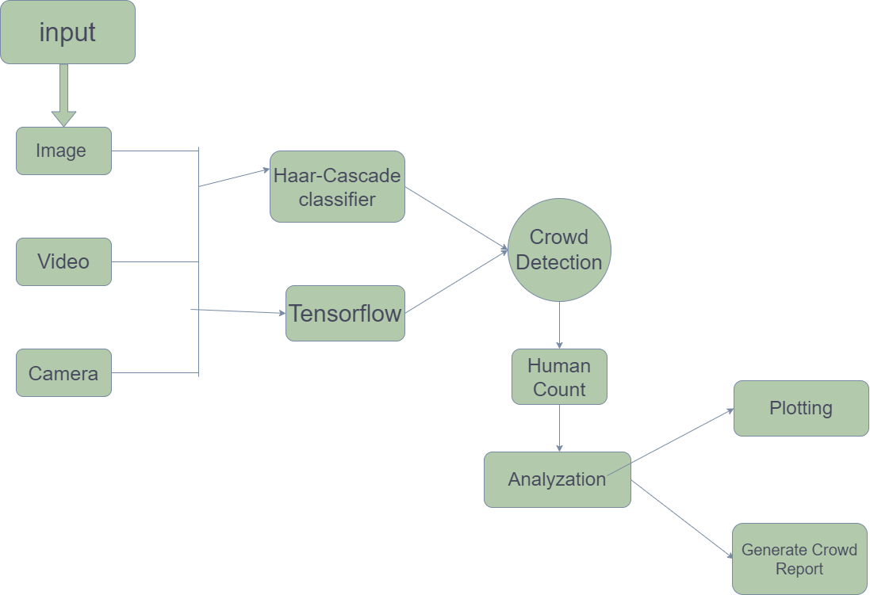
Proposed System

Slide 8
Questions and Answer..!!

